Slide 1
Introduction to Optimizations
Guo, Yao

Slide 2
Outline
Optimization Rules
Basic Blocks
Control Flow Graph (CFG)
  Loops
Local Optimizations
  Peephole optimization
Fall 2011
“Advanced Compiler Techniques”

Slide 3
Levels of Optimizations
Local
  inside a basic block
Global (intraprocedural)
  Across basic blocks
  Whole procedure analysis
Interprocedural
  Across procedures
  Whole program analysis
Fall 2011
“Advanced Compiler Techniques”

Slide 4
The Golden Rules of Optimization
Premature Optimization is Evil
Donald Knuth, premature optimization is the root of all evil
  Optimization can introduce new, subtle bugs
  Optimization usually makes code harder to understand and maintain
Get your code right first, then, if really needed, optimize it
  Document optimizations carefully
  Keep the non-optimized version handy, or even as a comment in your code
Fall 2011
“Advanced Compiler Techniques”

Slide 5
The Golden Rules of Optimization
The 80/20 Rule
In general, 80% percent of a program’s execution time is spent executing 20% of the code
90%/10% for performance-hungry programs
Spend your time optimizing the important 10/20% of your program
Optimize the common case even at the cost of making the uncommon case slower
Fall 2011
“Advanced Compiler Techniques”

Slide 6
The Golden Rules of Optimization
Good Algorithms Rule
The best and most important way of optimizing a program is using good algorithms
  E.g. O(n*log) rather than O(n²)
However, we still need lower level optimization to get more of our programs
In addition, asymptotic complexity is not always an appropriate metric of efficiency
  Hidden constant may be misleading
  E.g. a linear time algorithm than runs in 100*n+100 time is slower than a cubic time algorithm than runs in n³+10 time if the problem size is small
Fall 2011
“Advanced Compiler Techniques”
Notes:
asymptotic complexity: 渐进时间复杂度

Slide 7
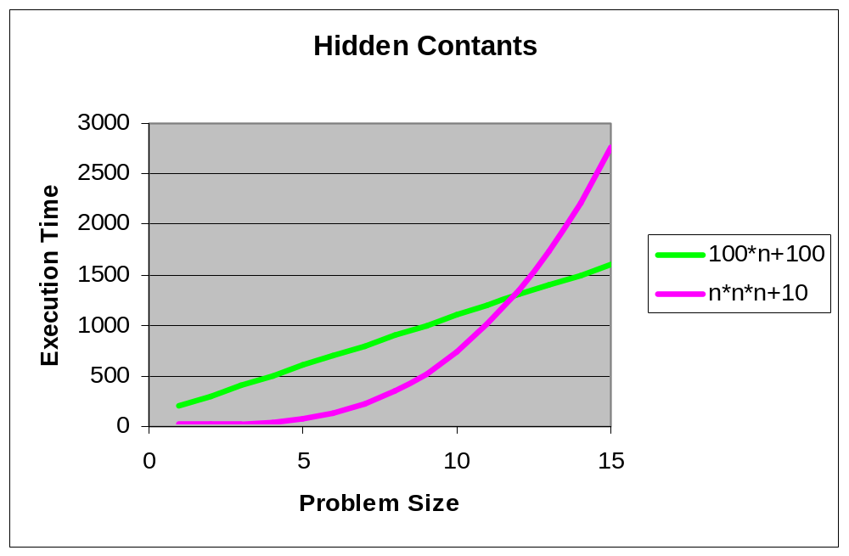
Asymptotic Complexity
Hidden Constants
Fall 2011
“Advanced Compiler Techniques”

Slide 8
General Optimization Techniques
Strength reduction
  Use the fastest version of an operation
  E.g.
    x >> 2 instead of x / 4
    x << 1 instead of x * 2
Common sub expression elimination
  Eliminate redundant calculations
  E.g.
    double x = d * (lim / max) * sx;
    double y = d * (lim / max) * sy;
    double depth = d * (lim / max);
    double x = depth * sx;
    double y = depth * sy;
Fall 2011
“Advanced Compiler Techniques”

Slide 9
General Optimization Techniques
Code motion
  Invariant expressions should be executed only once
  E.g.
    for (int i = 0; i < x.length; i++)
    x[i] *= Math.PI * Math.cos(y);
    double picosy = Math.PI * Math.cos(y);
    for (int i = 0; i < x.length; i++)
    x[i] *= picosy;
Fall 2011
“Advanced Compiler Techniques”

Slide 10
General Optimization Techniques
Loop unrolling
  The overhead of the loop control code can be reduced by executing more than one iteration in the body of the loop. E.g.
    double picosy = Math.PI * Math.cos(y);
    for (int i = 0; i < x.length; i++)
    x[i] *= picosy;
    double picosy = Math.PI * Math.cos(y);
    for (int i = 0; i < x.length; i += 2) {
    x[i] *= picosy;
    x[i+1] *= picosy;
    }
A efficient “+1” in array
indexing is required
Fall 2011
“Advanced Compiler Techniques”

Slide 11
Compiler Optimizations
Compilers try to generate good code
  i.e. Fast
Code improvement is challenging
  Many problems are NP-hard
Code improvement may slow down the compilation process
  In some domains, such as just-in-time compilation, compilation speed is critical
Fall 2011
“Advanced Compiler Techniques”

Slide 12
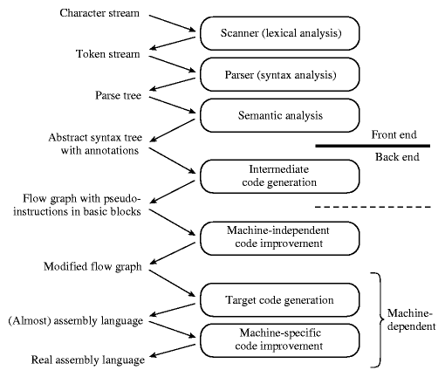
Phases of Compilation
The first three phases are language-dependent
The last two are machine-dependent
The middle two dependent on neither the language nor the machine
Fall 2011
“Advanced Compiler Techniques”

Slide 13
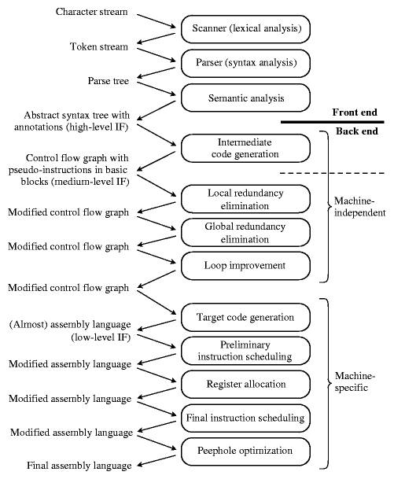
Phases
Fall 2011
“Advanced Compiler Techniques”
Notes:
Why is loop optimization important? 80/20 rule

Slide 14
Outline
Optimization Rules
Basic Blocks
Control Flow Graph (CFG)
  Loops
Local Optimizations
  Peephole optmization
Fall 2011
“Advanced Compiler Techniques”

Slide 15
Basic Blocks
A basic block is a maximal sequence of consecutive three-address instructions with the following properties:
  The flow of control can only enter the basic block thru the 1st instr.
  Control will leave the block without halting or branching, except possibly at the last instr.
Basic blocks become the nodes of a flow graph, with edges indicating the order.
Fall 2011
“Advanced Compiler Techniques”
Notes:
What happens if an interrupt happens???

Slide 16
Examples
i = 1
j = 1
t1 = 10 * i
t2 = t1 + j
t3 = 8 * t2
t4 = t3 - 88
a[t4] = 0.0
j = j + 1
if j <= 10 goto (3)
i = i + 1
if i <= 10 goto (2)
i = 1
t5 = i - 1
t6 = 88 * t5
a[t6] = 1.0
i = i + 1
if i <= 10 goto (13)
for i from 1 to 10 do
for j from 1 to 10 do
a[i,j]=0.0
for i from 1 to 10 do
a[i,i]=0.0
Fall 2011
“Advanced Compiler Techniques”

Slide 17
Identifying Basic Blocks
Input: sequence of instructions instr(i)
Output: A list of basic blocks
Method:
  Identify leaders:
  the first instruction of a basic block
  Iterate: add subsequent instructions to basic block until we reach another leader
Fall 2011
“Advanced Compiler Techniques”

Slide 18
Identifying Leaders
Rules for finding leaders in code
  First instr in the code is a leader
  Any instr that is the target of a (conditional or unconditional) jump is a leader
  Any instr that immediately follow a (conditional or unconditional) jump is a leader
Fall 2011
“Advanced Compiler Techniques”

Slide 19
Basic Block Partition Algorithm
leaders = {1} // start of program
for i = 1 to |n| // all instructions
if instr(i) is a branch
leaders = leaders U targets of instr(i) U instr(i+1)
worklist = leaders
While worklist not empty
x = first instruction in worklist
worklist = worklist – {x}
block(x) = {x}
for i = x + 1; i <= |n| && i not in leaders; i++
block(x) = block(x) U {i}
Fall 2011
“Advanced Compiler Techniques”

Slide 20
Basic Block Example
i = 1
j = 1
t1 = 10 * i
t2 = t1 + j
t3 = 8 * t2
t4 = t3 - 88
a[t4] = 0.0
j = j + 1
if j <= 10 goto (3)
i = i + 1
if i <= 10 goto (2)
i = 1
t5 = i - 1
t6 = 88 * t5
a[t6] = 1.0
i = i + 1
if i <= 10 goto (13)
A
B
Leaders
C
Basic Blocks
D
E
F
Fall 2011
“Advanced Compiler Techniques”

Slide 21
Outline
Optimization Rules
Basic Blocks
Control Flow Graph (CFG)
  Loops
Local Optimizations
  Peephole optmization
Fall 2011
“Advanced Compiler Techniques”

Slide 22
Control-Flow Graphs
Control-flow graph:
  Node: an instruction or sequence of instructions (a basic block)
    Two instructions i, j in same basic block
    iff execution of i guarantees execution of j
  Directed edge: potential flow of control
  Distinguished start node Entry & Exit
    First & last instruction in program
Fall 2011
“Advanced Compiler Techniques”

Slide 23
Control-Flow Edges
Basic blocks = nodes
Edges:
  Add directed edge between B1 and B2 if:
    Branch from last statement of B1 to first statement of B2 (B2 is a leader), or
    B2 immediately follows B1 in program order and B1 does not end with unconditional branch (goto)
  Definition of predecessor and successor
    B1 is a predecessor of B2
    B2 is a successor of B1
Fall 2011
“Advanced Compiler Techniques”

Slide 24
Control-Flow Edge Algorithm
Input: block(i), sequence of basic blocks
Output: CFG where nodes are basic blocks
for i = 1 to the number of blocks
x = last instruction of block(i)
if instr(x) is a branch
for each target y of instr(x),
create edge (i -> y)
if instr(x) is not unconditional branch,
create edge (i -> i+1)
Fall 2011
“Advanced Compiler Techniques”

Slide 25
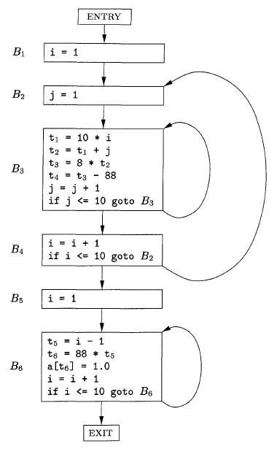
CFG Example
Fall 2011
“Advanced Compiler Techniques”

Slide 26
Loops
Loops comes from
  while, do-while, for, goto……
Loop definition: A set of nodes L in a CFG is a loop if
  There is a node called the loop entry: no other node in L has a predecessor outside L.
  Every node in L has a nonempty path (within L) to the entry of L.
Fall 2011
“Advanced Compiler Techniques”

Slide 27
Loop Examples
{B3}
{B6}
{B2, B3, B4}
Fall 2011
“Advanced Compiler Techniques”

Slide 28
Identifying Loops
Motivation
  majority of runtime
  focus optimization on loop bodies!
    remove redundant code, replace expensive operations ) speed up program
Finding loops:
  easy…
i = 1; j = 1; k = 1;
A1: if i > 1000 goto L1;
A2: if j > 1000 goto L2;
A3: if k > 1000 goto L3;
do something
k = k + 1; goto A3;
L3: j = j + 1; goto A2;
L2: i = i + 1; goto A1;
L1: halt
for i = 1 to 1000
for j = 1 to 1000
for k = 1 to 1000
do something
  or harder
  (GOTOs)
Fall 2011
“Advanced Compiler Techniques”

Slide 29
Outline
Optimization Rules
Basic Blocks
Control Flow Graph (CFG)
  Loops
Local Optimizations
  Peephole optmization
Fall 2011
“Advanced Compiler Techniques”

Slide 30
Local Optimization
Optimization of basic blocks
§8.5
Fall 2011
“Advanced Compiler Techniques”

Slide 31
Transformations on basic blocks
Common subexpression elimination: recognize redundant computations, replace with single temporary
Dead-code elimination: recognize computations not used subsequently, remove quadruples
Interchange statements, for better scheduling
Renaming of temporaries, for better register usage
All of the above require symbolic execution of the basic block, to obtain def/use information
Fall 2011
“Advanced Compiler Techniques”

Slide 32
Simple symbolic interpretation: next-use information
If x is computed in statement i, and is an operand of statement j, j > i, its value must be preserved (register or memory) until j.
If x is computed at k, k > i, the value computed at i has no further use, and be discarded (i.e. register reused)
Next-use information is annotated over statements and symbol table.
Computed on one backwards pass over statement.
Fall 2011
“Advanced Compiler Techniques”

Slide 33
Next-Use Information
Definitions
  Statement i assigns a value to x;
  Statement j has x as an operand;
  Control can flow from i to j along a path with no intervening assignments to x;
  Statement j uses the value of x computed at statement i.
  i.e., x is live at statement i.
Fall 2011
“Advanced Compiler Techniques”

Slide 34
Computing next-use
Use symbol table to annotate status of variables
Each operand in a statement carries additional information:
  Operand liveness (boolean)
  Operand next use (later statement)
On exit from block, all temporaries are dead (no next-use)
Fall 2011
“Advanced Compiler Techniques”

Slide 35
Algorithm
INPUT: a basic block B
OUTPUT: at each statement i: x=y op z in B, create liveness and next-use for x, y, z
METHOD: for each statement in B (backward)
  Retrieve liveness & next-use info from a table
  Set x to “not live” and “no next-use”
  Set y, z to “live” and the next uses of y,z to “i”
Note: step 2 & 3 cannot be interchanged.
  E.g., x = x + y
Fall 2011
“Advanced Compiler Techniques”

Slide 36
Example
x = 1
y = 1
x = x + y
z = y
x = y + z
Exit:
x: live, 6
y: not live
z: not live
Fall 2011
“Advanced Compiler Techniques”

Slide 37
Computing dependencies in a basic block: the DAG
Use directed acyclic graph (DAG) to recognize common subexpressions and remove redundant quadruples.
Intermediate code optimization:
  basic block => DAG => improved block => assembly
Leaves are labeled with identifiers and constants.
Internal nodes are labeled with operators and identifiers
Fall 2011
“Advanced Compiler Techniques”

Slide 38
DAG construction
Forward pass over basic block
For x = y op z;
  Find node labeled y, or create one
  Find node labeled z, or create one
  Create new node for op, or find an existing one with descendants y, z (need hash scheme)
  Add x to list of labels for new node
  Remove label x from node on which it appeared
For x = y;
  Add x to list of labels of node which currently holds y
Fall 2011
“Advanced Compiler Techniques”

Slide 39
DAG Example
Transform a basic block into a DAG.
+
c
a = b + c
b = a – d
c = b + c
d = a - d
b, d
-
+
a
d₀
b₀
c₀
Fall 2011
“Advanced Compiler Techniques”

Slide 40
Local Common Subexpr. (LCS)
Suppose b is not live on exit.
a = b + c
b = a – d
c = b + c
d = a - d
+
c
-
b, d
+
a
d₀
a = b + c
d = a – d
c = d + c
b₀
c₀
Fall 2011
“Advanced Compiler Techniques”

Slide 41
LCS: another example
e
+
a = b + c
b = b – d
c = c + d
e = b + c
+
a
-
b
+
c
b₀
c₀
d₀
Fall 2011
“Advanced Compiler Techniques”

Slide 42
Common subexp
Programmers don’t produce common subexpressions, code generators do!
Fall 2011
“Advanced Compiler Techniques”

Slide 43
Dead Code Elimination
Delete any root that has no live variables attached
a = b + c
b = b – d
c = c + d
e = b + c
e
+
c
On exit:
a, b live
c, e not live
+
a
-
b
+
b₀
c₀
d₀
a = b + c
b = b – d
Fall 2011
“Advanced Compiler Techniques”

Slide 44
Outline
Optimization Rules
Basic Blocks
Control Flow Graph (CFG)
  Loops
Local Optimizations
  Peephole optmization
Fall 2011
“Advanced Compiler Techniques”

Slide 45
Peephole Optimization
Dragon§8.7
Introduction to peephole
Common techniques
Algebraic identities
An example
Fall 2011
“Advanced Compiler Techniques”

Slide 46
Peephole Optimization
Simple compiler do not perform machine-independent code improvement
  They generates naive code
It is possible to take the target hole and optimize it
  Sub-optimal sequences of instructions that match an optimization pattern are transformed into optimal sequences of instructions
  This technique is known as peephole optimization
  Peephole optimization usually works by sliding a window of several instructions (a peephole)
Fall 2011
“Advanced Compiler Techniques”

Slide 47
Peephole Optimization
Goals:
- improve performance
- reduce memory footprint
- reduce code size
Method:
1. Exam short sequences of target instructions
2. Replacing the sequence by a more efficient one.
redundant-instruction elimination
algebraic simplifications
flow-of-control optimizations
use of machine idioms
Fall 2011
“Advanced Compiler Techniques”

Slide 48
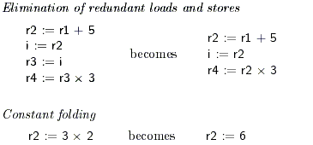
Peephole Optimization
Common Techniques
Fall 2011
“Advanced Compiler Techniques”
Notes:
常量叠算(Constant folding),还是叫常量合并，常量折叠

Slide 49
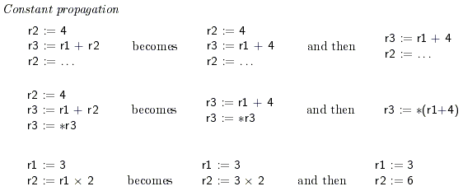
Peephole Optimization
Common Techniques
Fall 2011
“Advanced Compiler Techniques”

Slide 50
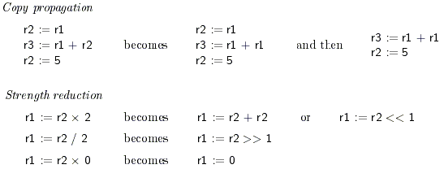
Peephole Optimization
Common Techniques
Fall 2011
“Advanced Compiler Techniques”

Slide 51

Peephole Optimization
Common Techniques
Fall 2011
“Advanced Compiler Techniques”

Slide 52
Algebraic identities
Worth recognizing single instructions with a constant operand
  Eliminate computations
    A * 1 = A
    A * 0 = 0
    A / 1 = A
  Reduce strenth
    A * 2 = A + A
    A/2 = A * 0.5
  Constant folding
    2 * 3.14 = 6.28
More delicate with floating-point
Fall 2011
“Advanced Compiler Techniques”
Notes:
algebraic identity 代数恒等式; 代数等价。

Slide 53
Is this ever helpful?
Why would anyone write X * 1?
Why bother to correct such obvious junk code?
In fact one might write
  #define MAX_TASKS 1
  ...
  a = b * MAX_TASKS;
Also, seemingly redundant code can be produced by other optimizations.
  This is an important effect.
Fall 2011
“Advanced Compiler Techniques”

Slide 54
Replace Multiply by Shift
A := A * 4;
  Can be replaced by 2-bit left shift (signed/unsigned)
  But must worry about overflow if language does
A := A / 4;
  If unsigned, can replace with shift right
  But shift right arithmetic is a well-known problem
  Language may allow it anyway (traditional C)
Fall 2011
“Advanced Compiler Techniques”

Slide 55
The Right Shift problem
Arithmetic Right shift:
  shift right and use sign bit to fill most significant bits
  -5 111111...1111111011
  SAR 111111...1111111101
  which is -3, not -2
  in most languages -5/2 = -2
Fall 2011
“Advanced Compiler Techniques”

Slide 56
Addition chains for multiplication
If multiply is very slow (or on a machine with no multiply instruction like the original SPARC), decomposing a constant operand into sum of powers of two can be effective:
  X * 125 = x * 128 - x*4 + x
  two shifts, one subtract and one add, which may be faster than one multiply
  Note similarity with efficient exponentiation method
Fall 2011
“Advanced Compiler Techniques”

Slide 57
Flow-of-control optimizations
goto L1
. . .
L1: goto L2
goto L2
. . .
L1: goto L2
if a < b goto L1
. . .
L1: goto L2
if a < b goto L2
. . .
L1: goto L2
goto L1
. . .
L1: if a < b goto L2
L3:
if a < b goto L2
goto L3
. . .
L3:
Fall 2011
“Advanced Compiler Techniques”

Slide 58
Peephole Opt: an Example
debug = 0
. . .
if(debug) {
print debugging information
}
Source Code:
debug = 0
. . .
if debug = 1 goto L1
goto L2
L1: print debugging information
L2:
Intermediate
Code:
Fall 2011
“Advanced Compiler Techniques”

Slide 59
Eliminate Jump after Jump
debug = 0
. . .
if debug = 1 goto L1
goto L2
L1: print debugging information
L2:
Before:
debug = 0
. . .
if debug ≠ 1 goto L2
print debugging information
L2:
After:
Fall 2011
“Advanced Compiler Techniques”

Slide 60
Constant Propagation
debug = 0
. . .
if debug ≠ 1 goto L2
print debugging information
L2:
Before:
debug = 0
. . .
if 0 ≠ 1 goto L2
print debugging information
L2:
After:
Fall 2011
“Advanced Compiler Techniques”

Slide 61
Unreachable Code
(dead code elimination)
debug = 0
. . .
if 0 ≠ 1 goto L2
print debugging information
L2:
Before:
debug = 0
. . .
After:
Fall 2011
“Advanced Compiler Techniques”

Slide 62
Peephole Optimization Summary
Peephole optimization is very fast
  Small overhead per instruction since they use a small, fixed-size window
It is often easier to generate naïve code and run peephole optimization than generating good code!
Fall 2011
“Advanced Compiler Techniques”

Slide 63
Summary
Introduction to optimization
Basic knowledge
  Basic blocks
  Control-flow graphs
Local Optimizations
  Peephole optimizations
Fall 2011
“Advanced Compiler Techniques”

Slide 64
Next Time
Dataflow analysis
  Dragon§9.2
Fall 2011
“Advanced Compiler Techniques”

